Slide 1
Obsessive-Compulsive and related Disorder
Prepared by Dr/Hanan yousif Aly

Slide 2
Obsessive – compulsive and related disorder:
OCD:
Body dysmorphic disorder:
Hoarding disorder:
Hair pulling disorder:
Excoriation (skin picking disorder):

Slide 3

Obsessive – compulsive disorder:

Slide 4
Definition:
An obsession
is a recurrent and persistent intrusive thought, images, impulses or sensation.
It is a mental event,
Most common obsessional themes;
    Contamination,
    Aggression, and violence,
    Responsibility for causing the harm by mistake,
    Sex,
    Religion,
    Perfectionism .

Slide 5
Definition
A compulsion is a behavior.
Specifically, a compulsion is a conscious, standardized, recurrent behavior, such as counting, checking, or avoiding.
Its aim is to Reduce anxiety ---→ -ve reinforcement ---→ increase anxiety.
Common compulsion--→ repeated checking, hand washing, counting , praying, repeated routine actions.

Slide 6

A patient with OCD realizes the irrationality of the obsession and experiences both the obsession and the compulsion as ego-dystonic (i.e., unwanted behavior)

Slide 7
OCD Cycle
Obsessions
Relief
Anxiety
Complusion

Slide 8
EPIDEMIOLOGY
A lifetime prevalence in the general population estimated at 2 to 3 percent.
The mean age of onset is about 20 years.
Male to female ratio: equal

Slide 9
ETIOLOGY
1- Biological:
Genetics
Relatives of families with OCD have a three- to fivefold higher probability of having OCD symptoms than families of control .
Serotonergic System
dysregulation (abnormalities) of serotonin .
Noradrenergic System
dysfunction in the noradrenergic system in OCD.

Slide 10
ETIOLOGY: Biological
Neuroimmunology
Some interest exists in a positive link between streptococcal infection and OCD. (PANDS……..>>pediatric autoimmune neuropsychiatric disorder associated with streptococcal infections)
Group A β - hemolytic streptococcal infection can cause rheumatic fever, and approximately 10 to 30 percent of the patients show obsessive-compulsive symptoms.

Slide 11
2- Psychological theories:
Behavioral theory:
The learning ( conditioning model) of OCD is based up on the two - factors theory of fear which proposes that obsessional anxiety is acquired by classical conditioning and maintained by operant conditioning.

Slide 12
Diagnosis :

Slide 13
A- Either obsessions or compulsions:
Obsessions as defined by (1), (2), (3), and (4):
  Recurrent and persistent thoughts, impulses, or images ; intrusive and inappropriate and that cause marked anxiety or distress .
  The thoughts, impulses, or images are not simply excessive worries about real-life problems.(Silly).
  The person attempts to ignore or suppress such thoughts, impulses, or images, (Resistance or out of his control).
  The person recognizes that the obsessional thoughts, impulses, or images are a product of his or her own mind (not imposed from as in thought insertion) (product of his mind).

Slide 14
Compulsions as defined by (1) and (2):
  Repetitive behaviors (e.g., hand washing, ordering, checking) or mental acts (e.g., praying, counting, repeating words silently) that the person feels driven to perform in response to an obsession, or according to rules that must be applied rigidly.
  The behaviors or mental acts are aimed at preventing or reducing distress.

Slide 15
B-The person has recognized that the obsessions or compulsions are excessive or unreasonable.
C- The obsessions or compulsions cause marked distress, are time-consuming (take more than 1 hour a day), social and occupational dysfunction..

Slide 16
D- Exclusion of other mental disorder.
E- Exclusion of the direct physiological effects of a substance (e.g., a drug of abuse, a medication) or a general medical condition.

Slide 17
OCD |  | Not OCD
A man who washes his hands 100 times a day until they are red and raw |  | A woman who certainly washes her hands before every meal
A women who locks and relocks her door before going to work every day – for half an hour |  | A woman who double-checks that her apartment door and windows are locked each night before she goes to bed.

Slide 18
Treatment:
Pharmacological and behavioral treatments have become common.
1- Pharmacological treatment:
2- Behavior Therapy:

Slide 19
1st line of treatment
SSRI
2nd line of treatment
Clomipramine
SNRI

Slide 20
2- Behavior Therapy:
The principal behavioral approaches in OCD are :
    Exposure and response prevention.
    Thought stopping,
    and Aversive conditioning have also been used in patients with OCD.

Slide 21
Other OCD related disorders

Slide 22
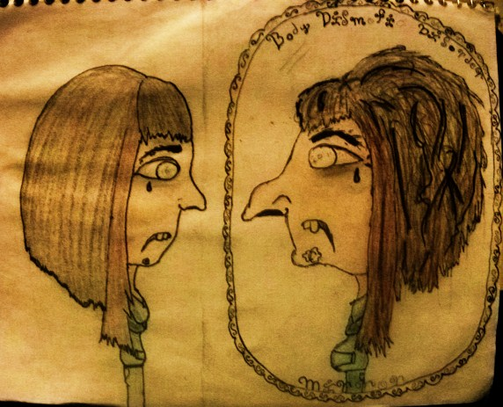
Body dysmorphic disorder:
It is characterized by imagined defect in appearance that causes clinically significant distress or impairment in important areas of functioning.

Slide 23
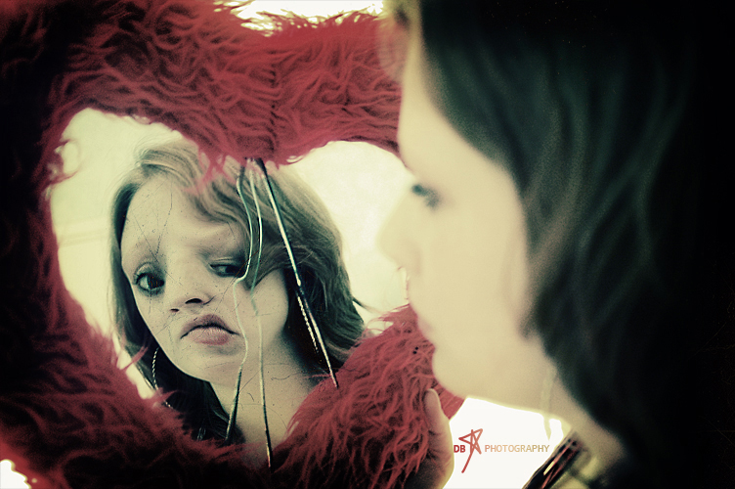
Diagnostic criteria
Preoccupation with one or more perceived defects in physical appearance that are not observable or appear slight to others.
The individual has performed repetitive behaviors (e.g., mirror checking,
excessive grooming, skin picking, reassurance seeking) or
mental acts (e.g., comparing his or her appearance
with that of others) in response to the appearance concerns.

Slide 24
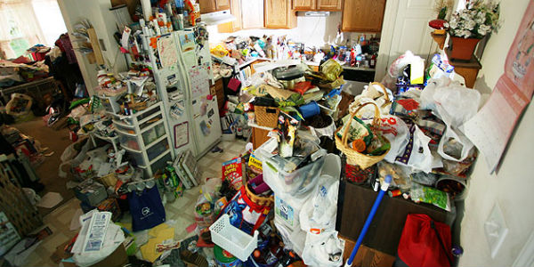
Hoarding disorder:

Slide 25
Diagnostic criteria:
Persistent difficulty in discarding of objects regardless of their actual value.
This difficulty is due to a perceived need to save the items and to distress associated with discarding them.

Slide 26
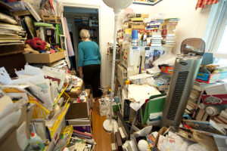
C. This results in the accumulation of possessions that congest and clutter active living areas

Slide 27
D. The hoarding causes impairment in social, occupational functioning (including maintaining a safe environment for self and others).
E. Exclusion of another medical condition (e.g., brain injury, cerebrovascular disease.)

Slide 28
F. The hoarding is not better explained by the symptoms of another mental disorder (e.g.,
obsessions in obsessive-compulsive disorder,
decreased energy in major depressive disorder,
delusions in schizophrenia or
another psychotic disorder,
cognitive deficits in major neurocognitive disorder,
restricted interests in autism spectrum disorder.

Slide 29
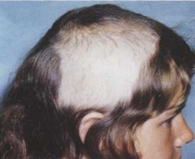
Hair pulling disorder (Trichotillomania)

Slide 30
Diagnostic criteria:
Recurrent pulling out of one’s hair, resulting in hair loss.
Repeated attempts to decrease or stop hair pulling.
The hair pulling causes clinically significant impairment in social, occupational functioning.
Exclusion of another medical condition (e.g., a dermatological condition).
Exclusion of other mental disorder

Slide 31

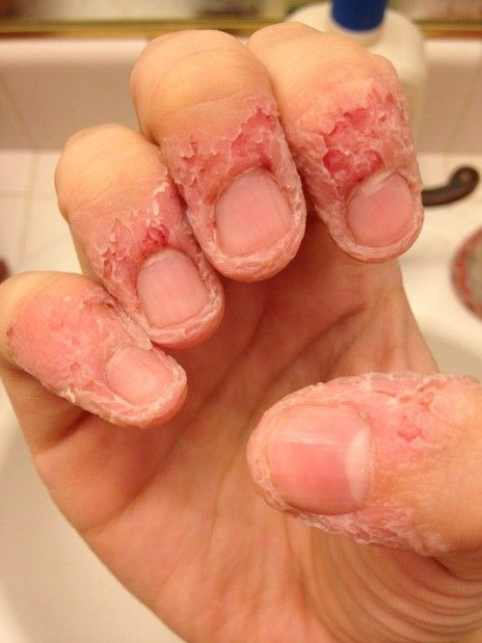
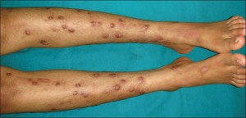
Excoriation (skin picking disorder):

Slide 32
Diagnostic criteria
Recurrent skin picking resulting in skin lesions.
Repeated attempts to decrease or stop skin picking.
The skin picking causes clinically significant impairment in social, occupational functioning.

Slide 33
Exclusion of other physiological effects of a substance (e.g., cocaine) or another medical condition (e.g., scabies).
The skin picking is not better explained by symptoms of another mental disorder (e.g.,
Delusions or tactile hallucinations in a psychotic disorder,
Attempts to improve a perceived defect or flaw in appearance in body dysmorphic disorder,
Stereotypies in stereotypic movement disorder, or
Intention to harm oneself in nonsuicidal self-injury).

Slide 34
Thank you

